Slide 1

IMDB MOVIE ANALYSIS
INDRANIL GHOSH

Slide 2
Data Cleaning, Visualization, and Database Operations
Using Python & MySQL
Presented by : INDRANIL GHOSH
Date : 15.04.2025

Slide 3
PROJECT OVERVIEW
Objective:
Analyze IMDb movie data using Python, visualize top-rated movies, and perform database operations using MySQL .
Key Components:
- Data Cleaning
- Data Visualization
- MySQL Integration (CRUD Operations)

Slide 4
DATA SOURCE
Dataset: IMDb Movies CSV file
Location: C:/Users/91743/Downloads/IMDB.csv
Columns Used:
- Title, Genre, Description, Director, Actors
- Year, Runtime, Rating, Votes, Revenue, Metascore

Slide 5
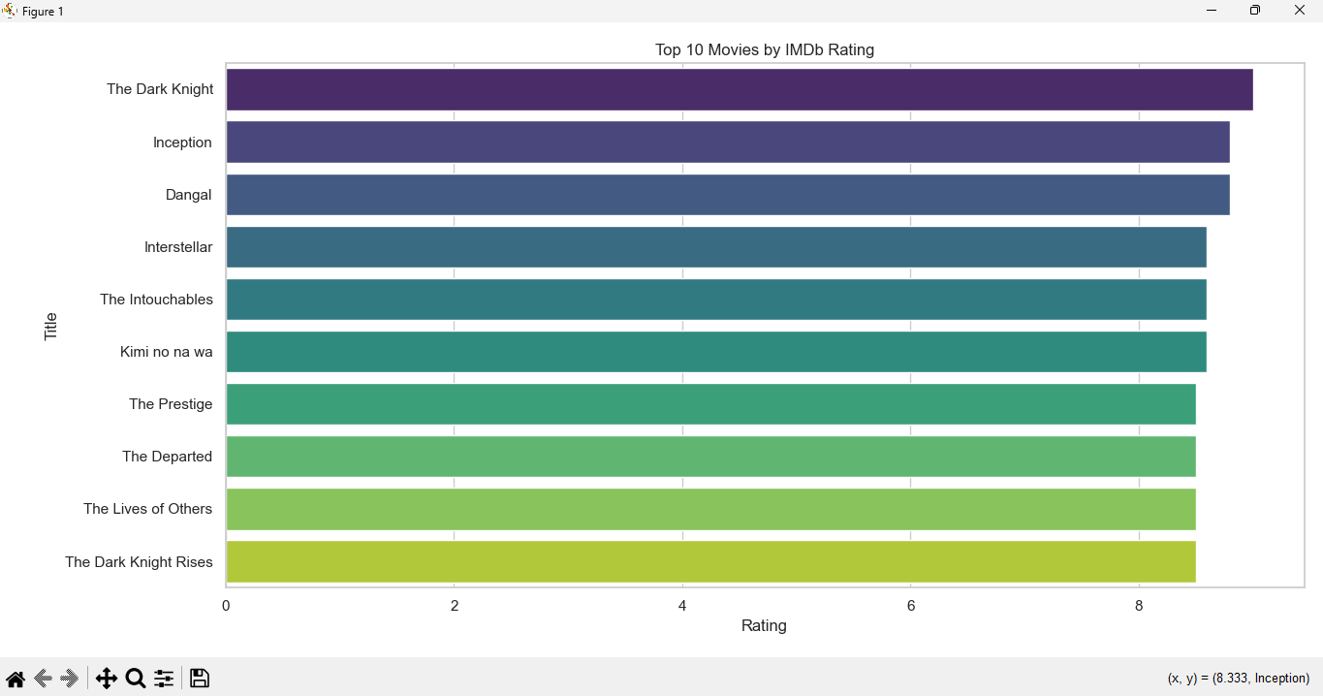
DATA CLEANNING & DATA VISUALIZATION
- Dropped unnecessary columns (Unnamed, Rank)
- Handled missing values in Revenue and Metascore
- Verified and aligned column types for consistency
- Chart: Top 10 Movies by IMDb Rating (barplot)
- Sorted by Rating descending
- Visualized using Seaborn (viridis palette)
- Helps quickly identify highest-rated movies

Slide 6
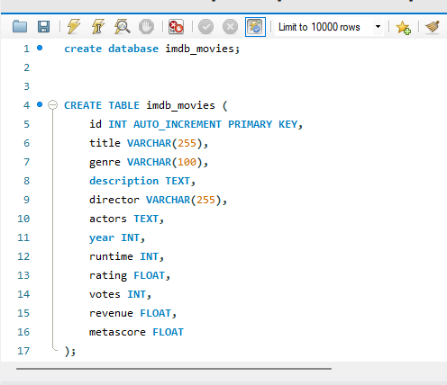
MySQL INTEGRATION
Connection Details:
- Host: localhost
- User: root
- Database: imdb_movies
Table Schema:
- title, genre, description, director, actors
- year, runtime, rating, votes, revenue, metascore

Slide 7
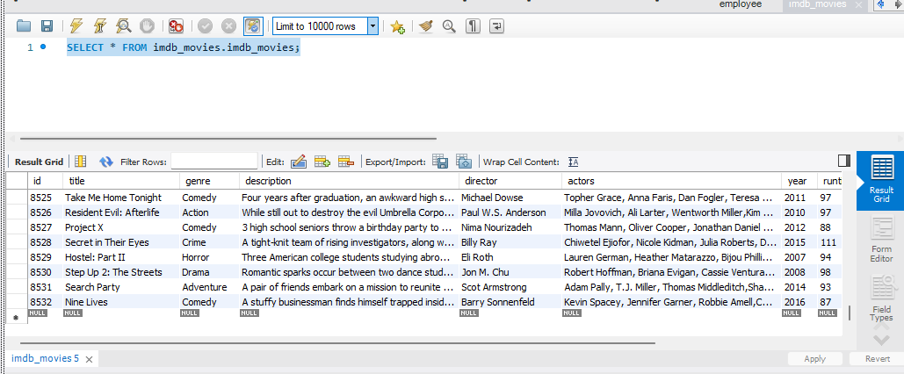
DATA INSERTION
- Converted DataFrame to list of tuples
- Used INSERT INTO imdb_movies VALUES (...)
- Inserted records row-by-row or via executemany() for optimization

Slide 8
CRUD OPERATIONS
Read:
SELECT * FROM imdb_movies LIMIT 5
Update:
UPDATE imdb_movies SET rating = 9.5 WHERE title = 'Inception'
Delete:
DELETE FROM imdb_movies WHERE year < 2000

Slide 9
IMPROVENENTS & FUTURE WORK
- Add GUI using Tkinter for easier data interaction
- Use environment variables for secure credentials
- Create advanced visualizations (e.g., genre-based analysis)
- Normalize data into multiple tables (e.g., Director, Actors)

Slide 10
THANK YOU

